Slide 1
Sprint 3 Presentation
Andrew Stepp, Brendan Cieslik, Yize Ma, Meihu Qin, Joe Prizlow, Connor Madek

Slide 2
Requirements
Web Application that allows account registration
Registering of buildings
Interactive map creating
Entries, exits, floors, hallways, offices, rest rooms, elevators, stairways
Map constructed as graph
Utilize Dijkstra for fastest route
Notes:
Joe’s Slide

Slide 3





Plan for this sprint
Create a grid for maps to be placed on and interact with
Create the grid
Create objects to input into the grid(generic building attributes)
Created difference in accounts between who makes maps and who can’t
Configure database for map storage
Write the program to upload maps
Notes:
joe?

Slide 4
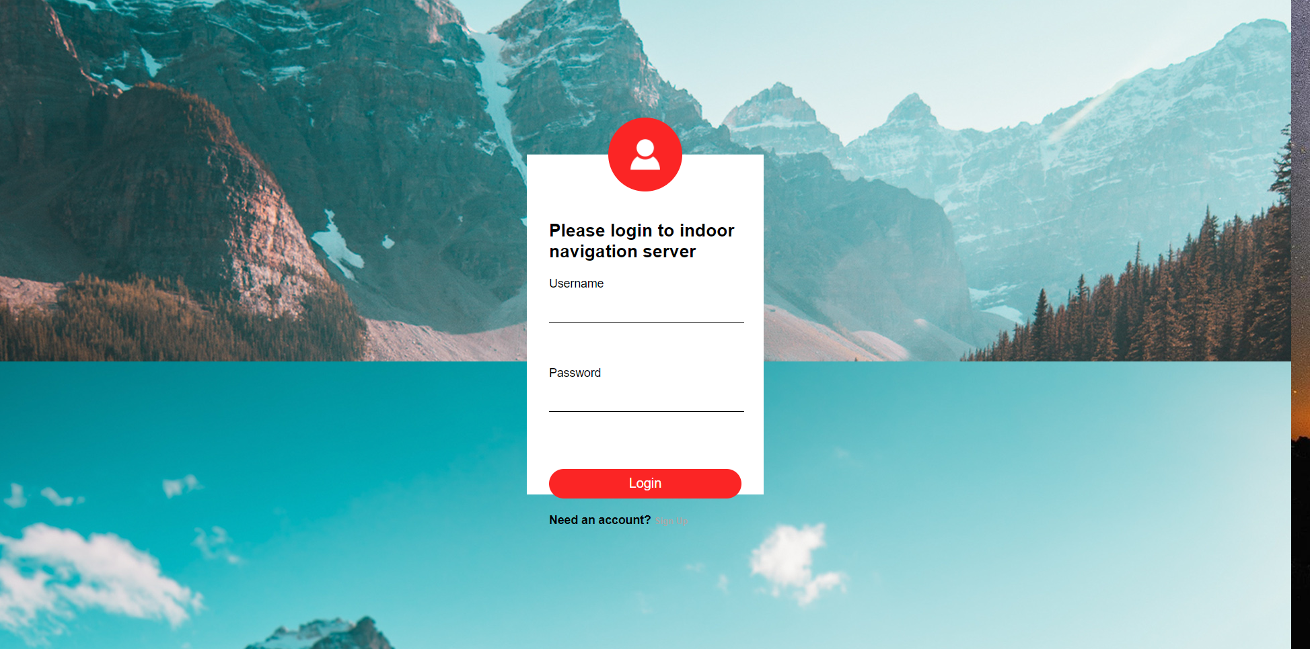
UI/UX
The UI/UX for this sprint was creating the grid for our map to be put into, as well as some objects that will represent different parts of buildings(these objects will get inserted into the Grid). The overall CSS will be carried over from the first iteration with some small changes to accomodate the methods we are using to build and display our maps.
Notes:
Yize

Slide 5
Challenges this sprint
Clashing schedules
Constructively using Github
Lack of common idea for how to move forward
Storing map information
Notes:
Connor

Slide 6
For next sprint
Implement the grid into the website behind the login page
Allow for saving of separate buildings
Associate these saves with the user who created them
Add tabs to website for different uses
Create tabs for constructing and viewing different grid objects
Separate tabs for other features we would like to implement
Build more building attribute objects
Allows users to specify certain areas with certain attributes
Complete map saving implementation
Complete requirements based on user stories
Notes:
Brendan

Slide 7
Thanks.

